Slide 1
Smart Bin
By-
Hack Slash

Slide 2

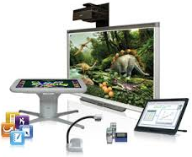

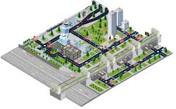
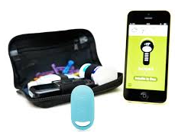
The World is going smart….
SMART Students
SMART Technology
SMART Cities
SMART Medication

Slide 3
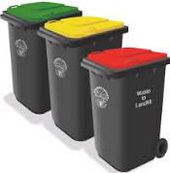
Then why not our bins ???

Slide 4

Why do we need a smart bin?
Every morning we dump our house waste into a city trawler or into a public bin.
The City Corporation has aligned workers to take care of these public bins.
With the growing population, these public bins have also increased.
But do we need to increase the number of workers???
An optimal way to manage these growing number of bins, is to make them
SMART

Slide 5
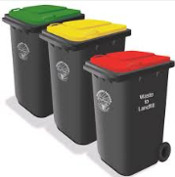
About the smart bin project
Smart Bin project is about Managing Bins.
Each bin is deployed with a sensor that analyzes the temperature, humidity and level of the waste.
These sensors transmit this information every 15 minutes to the server.
Workers are notified about these bins wherever there is -
An increase in temperature
An increase in humidity
The bin level is full and cannot accommodate more waste
These notifications are alarmed to the workers and indicate that these bins have to be emptied.

Slide 6

Thank you
Please contact the Hack Slash team for more information- raminder.rathore@gmail.com

